Slide 1
00 - Introduction

Slide 2
Contents
Artificial Intelligence vs Machine Learning vs Deep Learning
Types of Learning
Supervised
Unsupervised
Reinforcement

Slide 3
Machine Learning vs Deep Learning vs Artificial Intelligence

Slide 4
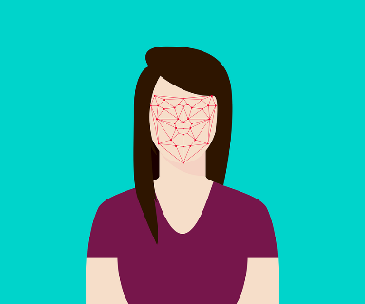
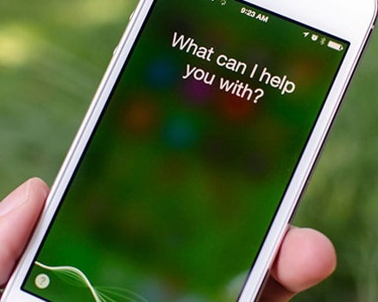

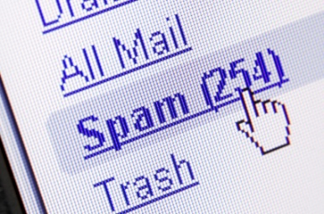
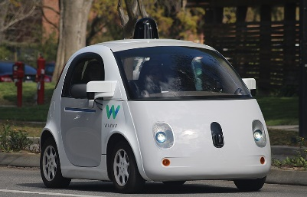

Introduction
Artificial Intelligence/Machine learning does not only mean robots or Sci-Fi movies!
Machine and deep learning applications are everywhere!
Google search engine, amazon recommender systems, Facebook facial recognition (tagging), Siri

Slide 5
Big Picture - AI
Artificial Intelligence
Science that empowers computers to mimic human intelligence such as decision making, text processing, and visual perception.

Slide 6
Big Picture - ML
Machine Learning
A subfield of Artificial Intelligence that enables machines to improve at a given task with experience.
All machine learning techniques are classified as Artificial Intelligence but not all Artificial Intelligence could count as Machine Learning.
e.g. some basic Rule-based engines could be classified as AI but they do not learn from experience therefore they do not belong to the machine learning category.

Slide 7
Big Picture - DL
Deep Learning
A specialized field of Machine Learning that relies on training of Deep Artificial Neural Networks (ANNs) using large dataset such as images.
ANNs are information processing models inspired by the human brain.
The human brain consists of billions of neurons that communicate to each other using electrical and chemical signals and enable humans to see, feel, and make decision.

Slide 8
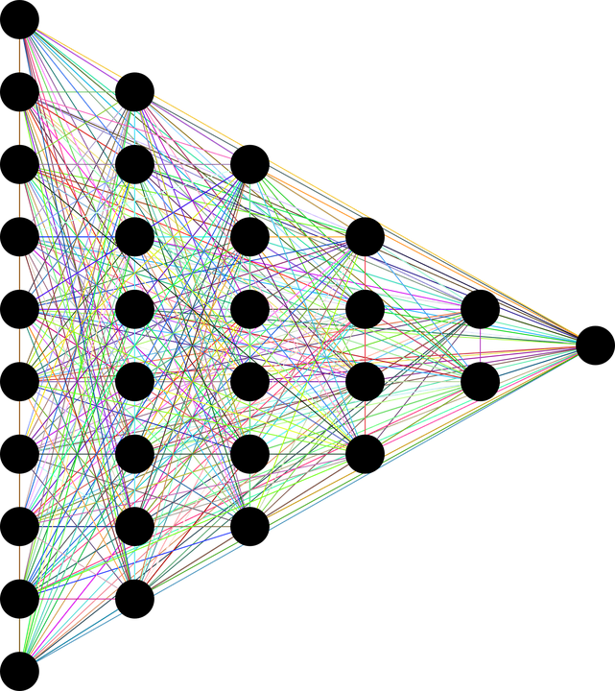
Big Picture - DL
Deep Learning
Depth is a measure of how many hidden layers
More than three layers (including input and output) qualifies as“deep” learning.
INPUT
DATA
TARGET OUTPUTS
DEEP (HIDDEN LAYERS)

Slide 9



AI vs ML vs DL
Deep learning can automatically extract features automatically:
Machine learning Process:
select the model to train,
manually perform feature extraction.
Deep Learning Process:
select the architecture of the network,
features are automatically extracted by feeding in the training data (such as images) along with the target class (label).
MACHINE LEARNING
DEEP LEARNING
Manual Feature
Extraction
Classification
Learned Features
Convolutional Neural Network
(CNN)
CAT
Machine
Learning
CAT
DOG
DOG
MOUSE
MOUSE

Slide 10
Types of Learning

Slide 11
Types of Learning
SUPERVISED LEARNING
Training algorithms using labeled input/output data.
CLASSIFICATION
ARTIFICIAL INTELLIGENCE
Science that enables computers to mimic human intelligence. Subfields: Machine Learning, robotics, and computer vision
MACHINE LEARNING
Subset of AI that enable machines to improve at tasks with experience
REGRESSION
UNSUPERVISED LEARNING
Training algorithms with no labeled data. It attempts at discovering hidden patterns on its own.
CLUSTERING
REINFORCEMENT LEARNING
Algorithm take actions to maximize cumulative reward.

Slide 12
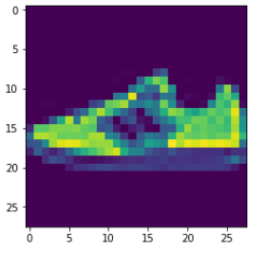
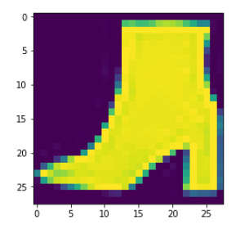
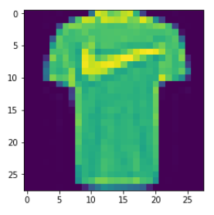
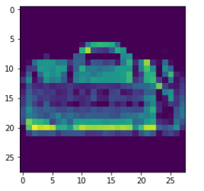

Supervised Learning
Supervised: used to train algorithms using labeled input and output data.
Performance is assessed by comparing trained model prediction vs. real output.
INPUT DATA ($X _train$)
DESIRED OUTPUT TARGET CLASSES / LABELS (y _train)
T-SHIRT/TOP
TROUSER
PULLOVER
DRESS
COAT
SANDAL
SHIRT
SNEAKER
BAG
ANKLE BOOT
MODEL
Fashion Data Set

Slide 13
Unsupervised Learning
Unsupervised learning: provides the algorithm with no labeled data.
The algorithm attempts at discovering hidden patterns within the training data.
Unsupervised learning methods can analyze complex data that humans might find difficult to interpret.
No feedback!
DATA CLUSTERS
INPUT DATA
MODEL

Slide 14
Reinforcement Learning
Reinforcement learning allows machines take actions to maximize cumulative reward.
Reinforcement algorithms learn by trial and error through reward and penalty.
Two elements: environment and learning agent.
The environment rewards the agent for correct actions.
Based on the reward or penalty, agent improves its environment knowledge to make better decision.
Key Words
Trial
&
Error

Slide 15
01 - Regression

Slide 16
Contents
Car Sales Regression Problem
Artificial Neural Networks
Training a Neural Network
Multi Neural Networks

Slide 17
Car Sales Problem Statement

Slide 18
Problem Statement
You are working as a car salesman and you would like to develop a model to predict the total dollar amount that customers are willing to pay given the following attributes:
Customer Name
Customer e-mail
Country
Gender
Age
Annual Salary
Credit Card Debt
Net Worth
The model should predict:
Car Purchase Amount
This is a
REGRESSION TASK

Slide 19
Regression
Regression works by predicting value of one variable y based on another variable X.
X is called the independent variable and y is called the dependant variable.
Annual Salary |  | Car Purchase Amount
62812 |  | 35321
66647 |  | 45116
53799 |  | 42926
79370 |  | 67422
59729 |  | 55915
68500 |  | 56612
39815 |  | 28926
51752 |  | 47435
58139 |  | 48014
53457 |  | 38190
73349 |  | 59046
55422 |  | 42289
37336 |  | 28700
68304 |  | 49259
72776 |  | 49510
CAR PURCHASE AMOUNT
ANNUAL SALARY

Slide 20
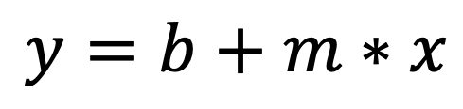
Regression
Goal is to obtain a relationship (model) between the Annual salary and car purchasing amount.
MODEL! (GOAL)
$$y=b+m∗x$$
$2K
CAR PURCHASING AMOUNT
DEPENDANT VARIABLE
CAR PURCHASING AMOUNT ($)
INDEPENDENT VARIABLE
ANNUAL SALARY ($)
+10K
ANNUAL SALARY

Slide 21
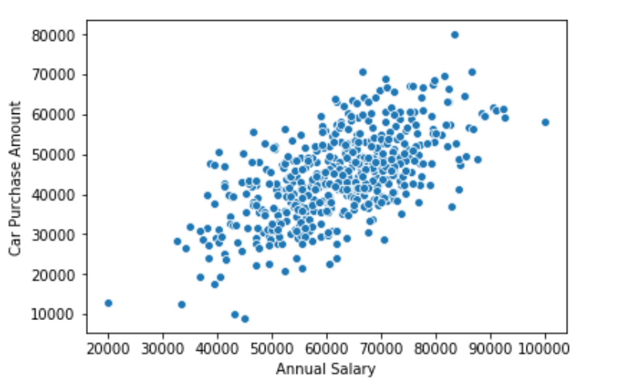

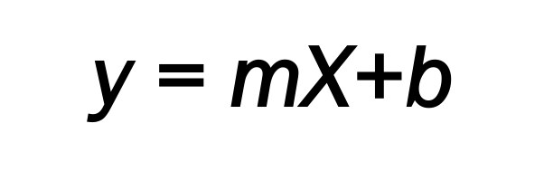
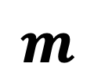


Regression
Once the coefficients ‘m’ and ‘b’ are obtained, you have obtained a regression model!
This “trained” model can be later used to predict car purchase amount (dollars) based on the annual salary.
$$Y$$
$$\text{y}\text{ = }\text{mX}\text{+}\text{b}$$
DEPENDANT
VARIABLE
INDEPENDANT
VARIABLE
$$m$$
$$b$$
$$X$$

Slide 22
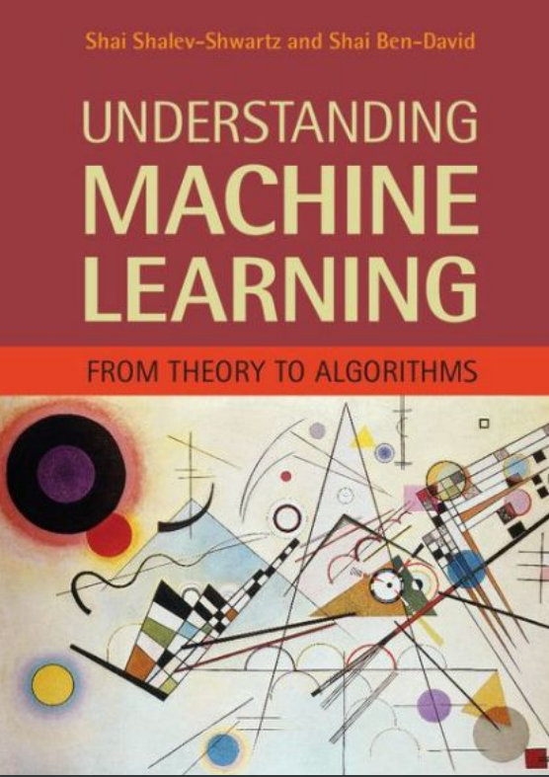
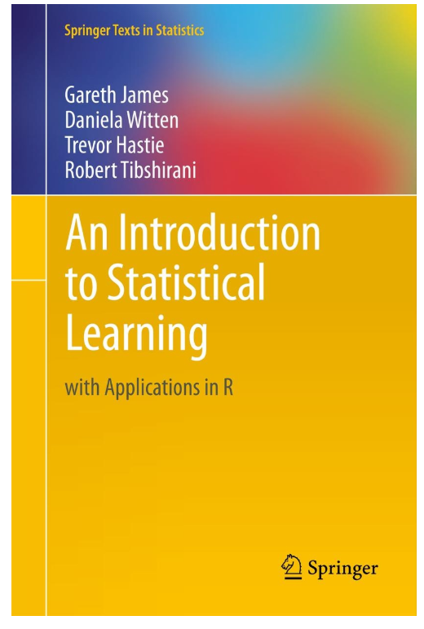
Additional Resources
Additional Resources, Page #123: http://www.cs.huji.ac.il/~shais/UnderstandingMachineLearning/understanding-machine-learning-theory-algorithms.pdf
Additional Resources, Page #61:
http://www-bcf.usc.edu/~gareth/ISL/ISLR%20Seventh%20Printing.pdf

Slide 23
Artifical Nerural Networks

Slide 24
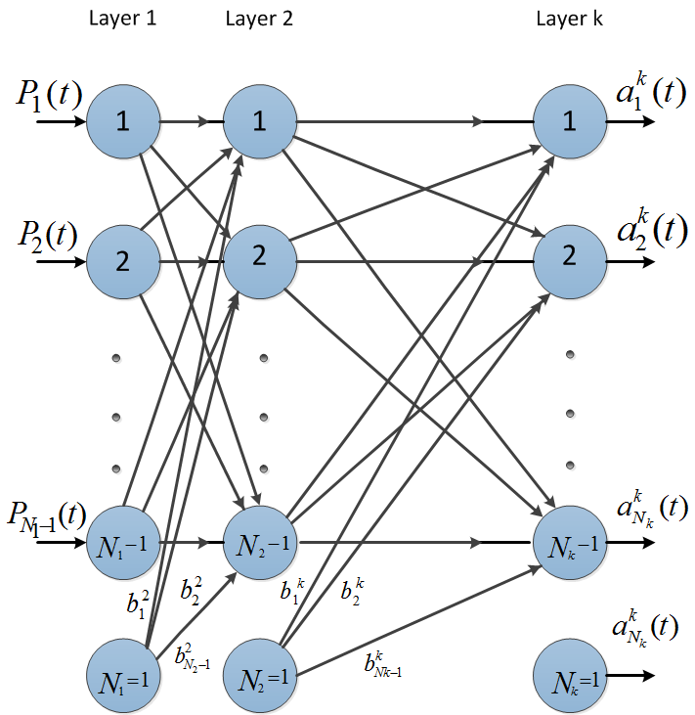
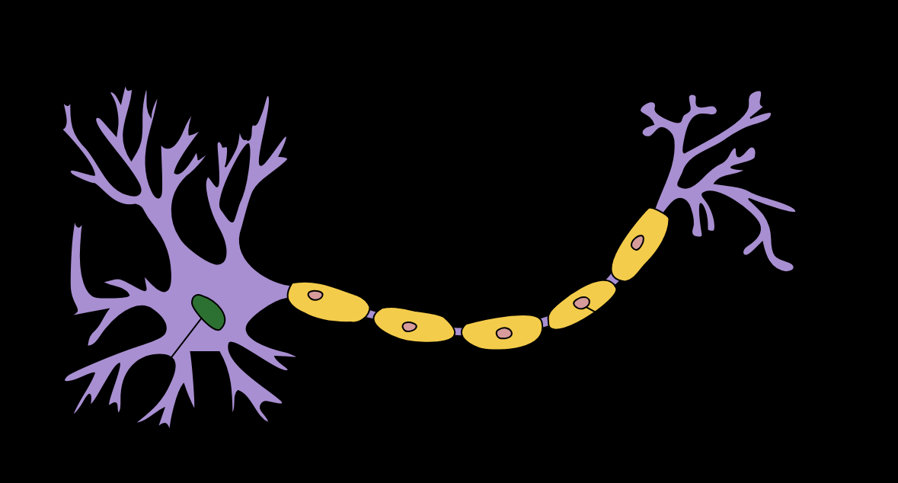
A.N.N. - Introduction
The brain has over 100 billion neurons communicating through electrical and chemical signals.
Neurons communicate with each other and help us see, think, and generate ideas.
Human brain learns by creating connections among these neurons.
ANNs are information processing models inspired by the human brain.

Slide 25
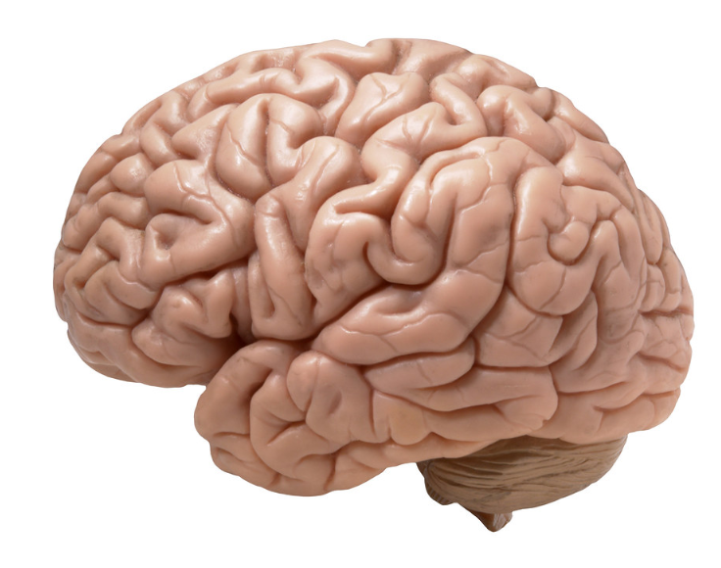
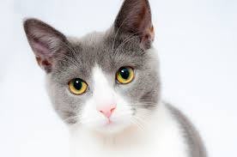
How to humans learn ?
Humans learn from experience (by example)
~Desired Outputs
LABEL: CAT!
Inputs
Deviated Outputs
Desired (Correct) Output
Update
Error

Slide 26
Neuron Mathematical Model
The neuron collects signals from input channels named dendrites, processes information in its nucleus, and then generates an output in a long thin branch called axon.
X1
W1
NEURON
X2
W2
W3
X3
DENDRITES
AXON
NUCLEUS

Slide 27








Neuron Mathematical Model
Bias allows to shift the activation function curve up or down.
Number of adjustable parameters = 4 (3 weights and 1 bias).
Activation function “F”.
b
$$X_{1}$$
$$W_{1}$$
F
INPUTS/INDEPENDENT VARIABLES
$$W_{2}$$
$$X_{2}$$
$$W_{3}$$
$$X_{3}$$
$$y=f(X_{1}W_{1}+X_{2}W_{2}+X_{3}W_{3}+b)$$

Slide 28
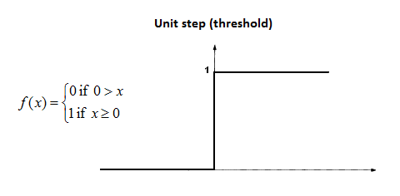










Single Neuron Model
Assume that the activation function is a Unit Step Activation Function.
The activation functions is used to map the input between (0, 1).
$$X_{1}$$
$$b=0$$
Input #1=1
$W_{1}$=0.7
F
$$W_{2}=0.1$$
Input #2=3
$$X_{2}$$
$$W_{3}=0.3$$
$$y=f\left(X_{1}W_{1}+X_{2}W_{2}+X_{3}W_{3}+b\right)$$
Input #3=4
$$X_{3}$$
$$y=f\left(1∗0.7+3∗0.1+4∗0.3\right)=f(2.2)$$
$$y=1 (because 2.2>0)$$

Slide 29
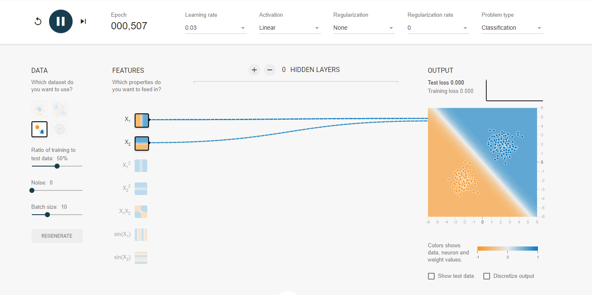
Single Neuron Model
Try a neural network out : https://playground.tensorflow.org

Slide 30
Training a Network

Slide 31
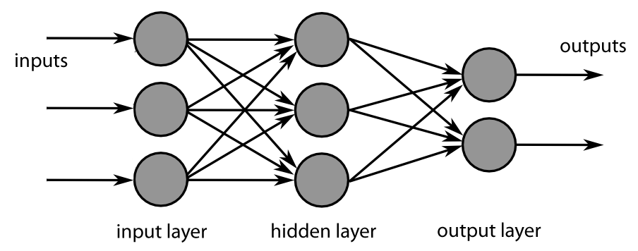
Back Propagation
A method used to train ANNs by calculating gradient needed to update network weights.
STEP 1:
FORWARD PROPAGATION
STEP 2:
ERROR
CALCULATION
STEP 4:
WEIGHT
UPDATE
Often used by the gradient descent optimization algorithm to adjust the weight of neurons by calculating the gradient of the loss function.
STEP 3:
BACK PROPAGATION

Slide 32
Back Propagation – Phase 1 - Propagation
Propagation forward through the network to generate the output value(s)
Calculation of the cost (error term)
Propagation of output activations back through network using training pattern target in order to generate the deltas (difference between targeted and actual output values)
STEP 1:
FORWARD PROPAGATION
STEP 2:
ERROR
CALCULATION
STEP 4:
WEIGHT
UPDATE
STEP 3:
BACK PROPAGATION

Slide 33
Back Propagation – Phase 2 – Weight Update
Calculate weight gradient
A ratio (percentage) of the weight's gradient is subtracted from the weight.
This ratio influences the speed and quality of learning and called learning rate. The greater the ratio, the faster neuron train, but lower ratio, more accurate the training is.
STEP 1:
FORWARD PROPAGATION
STEP 2:
ERROR
CALCULATION
STEP 4:
WEIGHT
UPDATE
STEP 3:
BACK PROPAGATION

Slide 34
Multi Neuron Model

Slide 35
2 Neurons
The network is represented by a matrix of weights, inputs and outputs.
Total Number of adjustable parameters = 8:
Weights = 6
Biases = 2
P1
W1
W2
n1
a1
Matrix Representation
P2
∑
f
W3
P3
b1
P1
W1
W2
n2
a2
P2
∑
f
W3
P3
b2

Slide 36
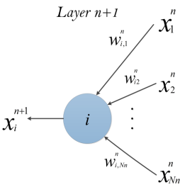



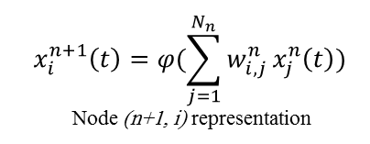
Multi Neuron Network - Matrices
$$x_{i}^{n+1}\left(t\right)=φ(\sum_{j=1}^{N_{n}}{w_{i, j}^{n}}x_{j}^{n}\left(t\right))$$
Node (n+1, i) representation
$$\left[\begin{matrix}\begin{matrix}W_{11} & W_{12} \\ W_{21} & W_{22}\end{matrix} & ⋯ & \begin{matrix}W_{1{, N}_{1}} \\ W_{2{, N}_{1}}\end{matrix} \\ ⋮ & ⋱ & ⋮ \\ \begin{matrix}W_{m−1,1} & W_{m−1,2} \\ W_{m,1} & W_{m,2}\end{matrix} & ⋯ & \begin{matrix}W_{m−1{, N}_{1}} \\ W_{m{, N}_{1}}\end{matrix}\end{matrix}\right]$$
Non-Linear Sigmoid Activation function
$$φ\left(w\right)=\frac{1}{1+e^{−w}}$$
m: number of neurons in the hidden layer
$N_{1}$: number of inputs

Slide 37
Questions
?

